Slide 1
Presentation by Md. Rakibul Islam
Transitions & Animation Testing

Slide 2
Division of Bangladesh
Division
Dhaka
Barishal
Sylhet
Chittagonj
Khulna
Rajshahi
Cumilla
Mymensingh

Slide 3
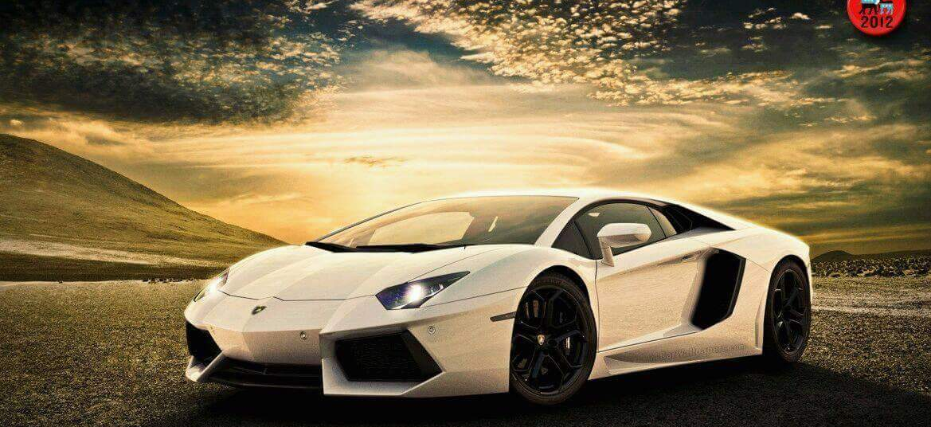
CAR

Slide 4
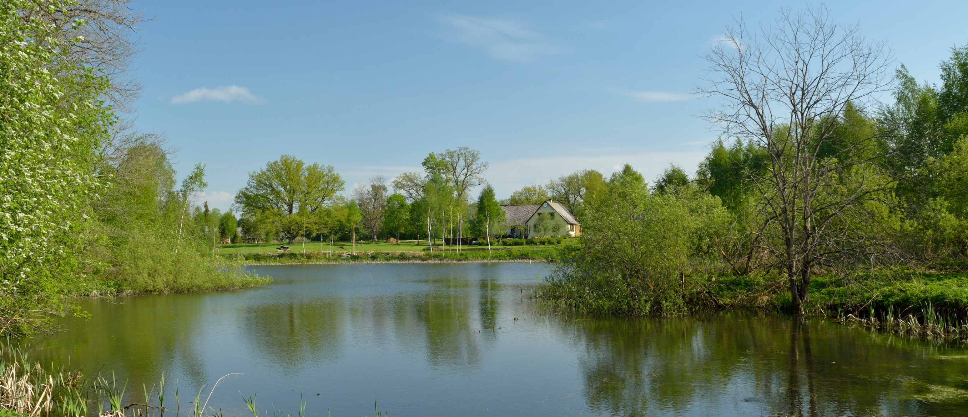
RIVER

Slide 5

ICE

Slide 6
End of The Presentation

